Slide 1
Processing text data with Quantum Computers
Antonio Villalpando Barroso (ICHEC)
Quantum flagship NLP Webinar
February 2022

Slide 2




What is NLP?
Branch of AI which allows computers to understand, analyze and respond to natural language.
Common NLP tasks:
Erwin Schrödinger (person) was an Austrian-Irish (nationality) physicist (profession) born in 1887 (year)...
Topic classification
Politics
Machine translation
Tree
Named entity recognition
Raw Data
Sports
Technology
Document retrieval
Sentiment analysis
Text summarization
Question answering

Slide 3
History of NLP
2014:
GloVe: Global Vectors for Word Representation
Seq2Seq Models (LSTM, RNNS, GRU)
1950s:
Georgetown experiment
Turin test
Grammar theories
2000s:
Neural network models
Word embeddings
2018:
Contextual Transformer-based word embeddings (ELMO, BERT)
1970s:
Early chatbots
Conceptual ontologies
1960s:
Restricted vocabulary natural language understanding programs (ELIZA, SHRDLU)
1980-90s:
Machine learning
Statistical models
Decision trees
2013:
Word2Vec
2017:
Transformer: Attention is all you need
2019-now:
Attention alternatives (LinFormer, PerFormer, XLNet, FNet…)

Slide 4
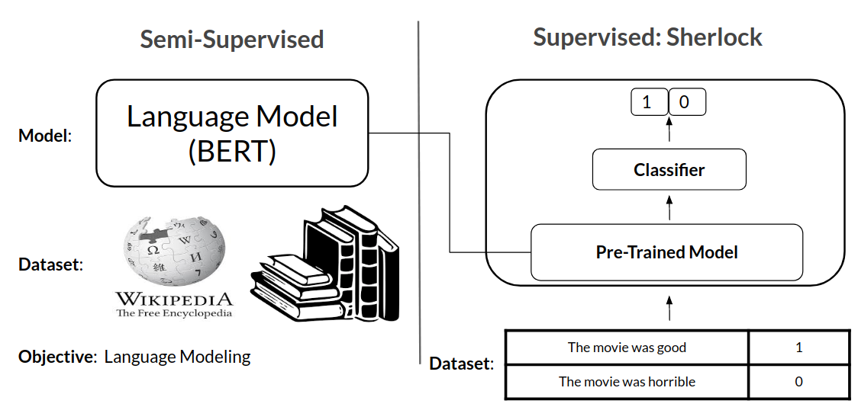
Classical NLP pipeline
Text processing pipeline:
Tokens are parametrized into (word or subword) vectors:
Hot one encoding (sparse)
Word2Vec (dense)
Context dependent (Bert, Elmo…)
Transfer learning:
Pretrained models are used as the input embeddings for specific task or datasets.
For example, BERT (Bidirectional Encoder Representations from Transformers) is
first trained by predicting words in a masked corpus.
Processed document object
Raw text
Tokenize
Tagging
Parsing
…
https://blog.insightdatascience.com/using-transfer-learning-for-nlp-with-small-data-71e10baf99a6
Notes:
Token: Segment text, and create Doc objects with the discovered segment boundaries.
Tagging: A trainable pipeline component to predict part-of-speech tags for any part-of-speech tag set.
Parsing: Pipeline component for syntactic dependency parsing
How the word2vec model is trained
Move through the training corpus with a sliding window: Each word is a prediction problem.
The objective is to predict the current word using the neighboring words (or vice versa).
The outcome of the prediction determines whether we adjust the current word vector. Gradually, vectors converge to (hopefully) optimal values.

Slide 5
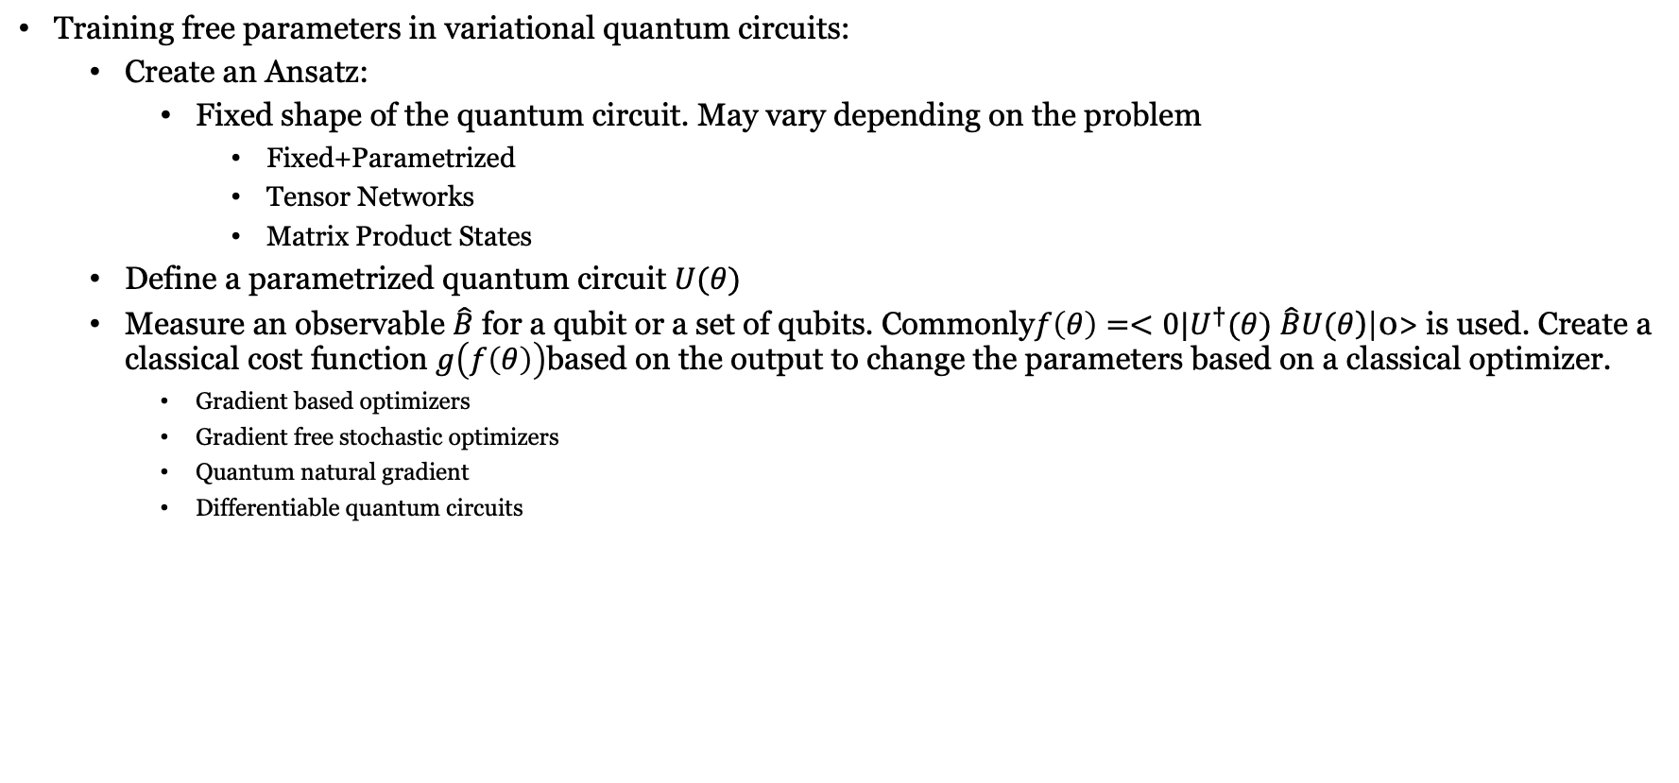
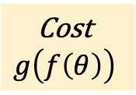

Quantum machine learning
Training free parameters in variational quantum circuits:
Create an Ansatz:
Fixed shape of the quantum circuit. May vary depending on the problem
Fixed+Parametrized
Tensor Networks
Matrix Product States
Define a parametrized quantum circuit $U(θ)$
Measure an observable $\hat{B}$ for a qubit or a set of qubits. Commonly$f\left(θ\right)=<0|U^{†}(θ)$ $\hat{B}U(θ$)|0> is used. Create a classical cost function $g\left(f\left(θ\right)\right)$based on the output to change the parameters based on a classical optimizer.
Gradient based optimizers
Gradient free stochastic optimizers
Quantum natural gradient
Differentiable quantum circuits
|0>
$$U(θ)$$
Cost
$$g\left(f\left(θ\right)\right)$$
|0>
Optimizer
Notes:
In the context of variational circuits, an ansatz usually describes a subroutine consisting of a sequence of gates applied to specific wires. Similar to the architecture of a neural network, this only defines the base structure, while the types of gates and/or their free parameters can be optimized by the variational procedure.
Many variational circuit ansaetze [1] have been proposed by the quantum computing community. The strength of an ansatz depends on the desired use-case, and it is not always clear what makes a good ansatz.
One can distinguish three different base structures, namely a layered gate ansatz, an alternating operator ansatz, and a tensor network ansatz.

Slide 6
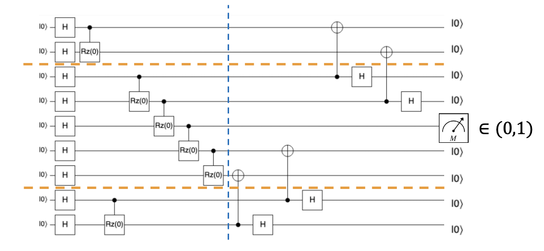









Experimental results: True/False classification using DisCoCat diagrams
$$(|s_{0}>,label_{0})$$
$$|w_{0}>$$
$$|w_{1}>$$
…
$$|w_{2}>$$
…
$$|w_{i}>$$
$$(|s_{n}>,label_{n})$$
…
$$|w_{m−1}>$$
Custom cost function
$$|w_{m}>,$$
$$Update parameters$$
Classical Optimizers

Slide 7
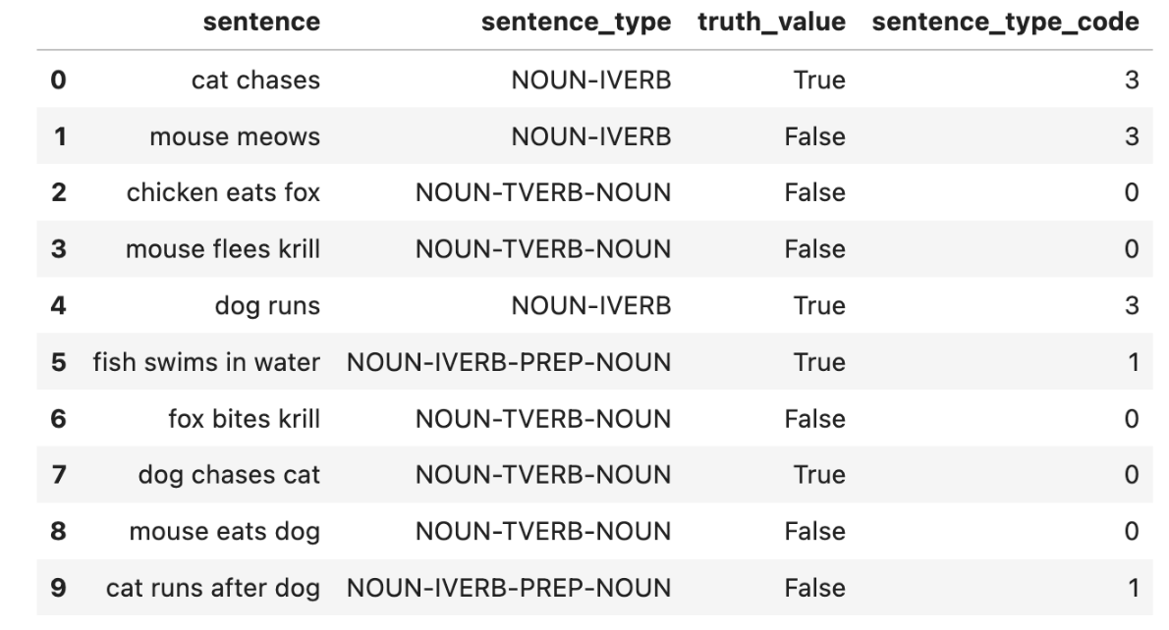

Experiments: True/False classification
Datasets considered were created specifically for the implementation. It includes several sentence types labelles as True/False stating facts about the Animal Kingdom.
For each sentence, a cost function is calculated. Cross entropy is used as we have a binary classification problem.
The loss function is then obtained for the whole dataset:

Slide 8
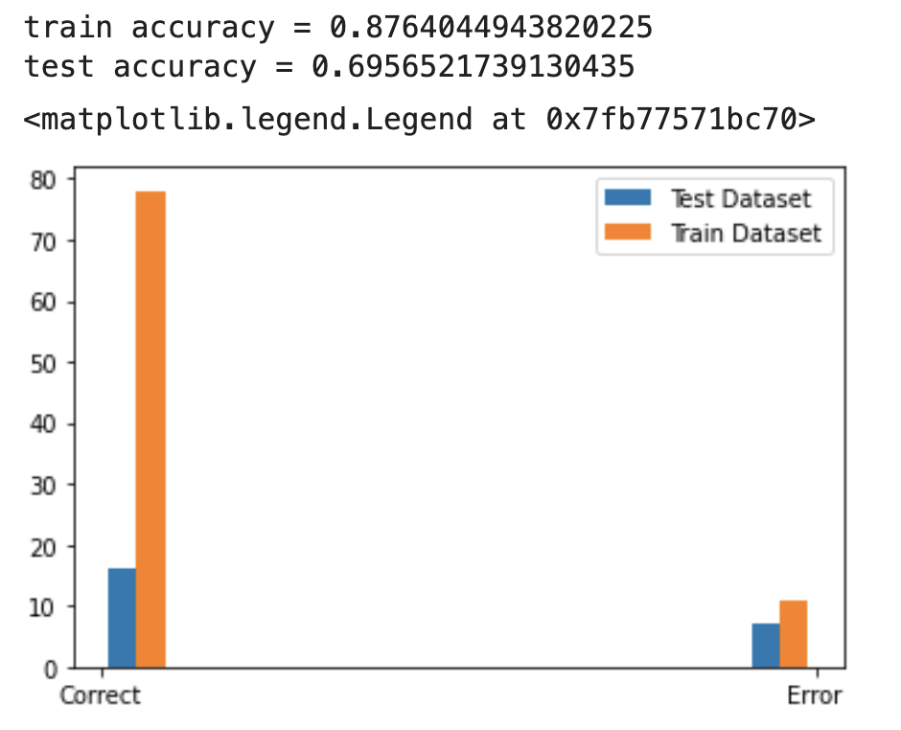
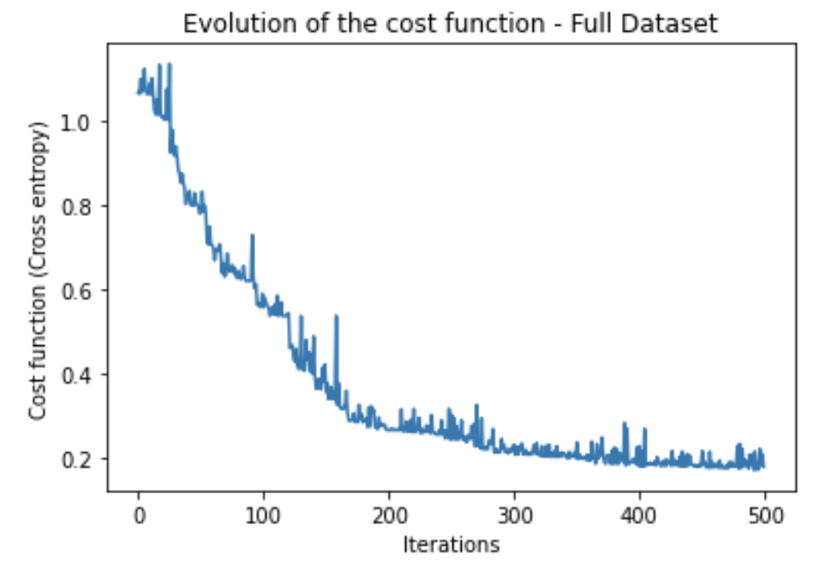
Experiments: True/False classification
Model trained for whole datatset and transitive-only sentences.
VQE-like problem
‘COBYLA’ used as classical optimizer for the quantum algorithm.

Slide 9
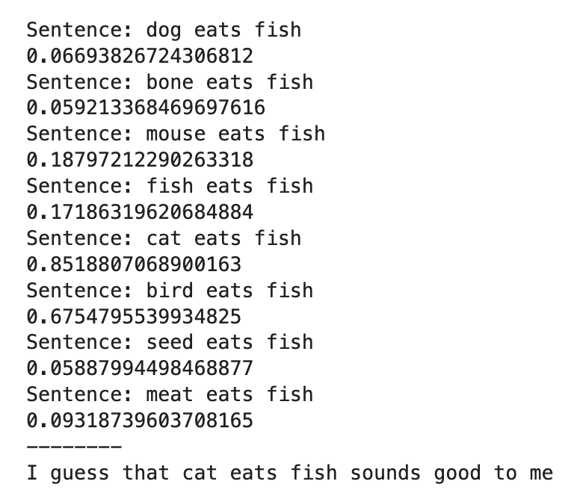
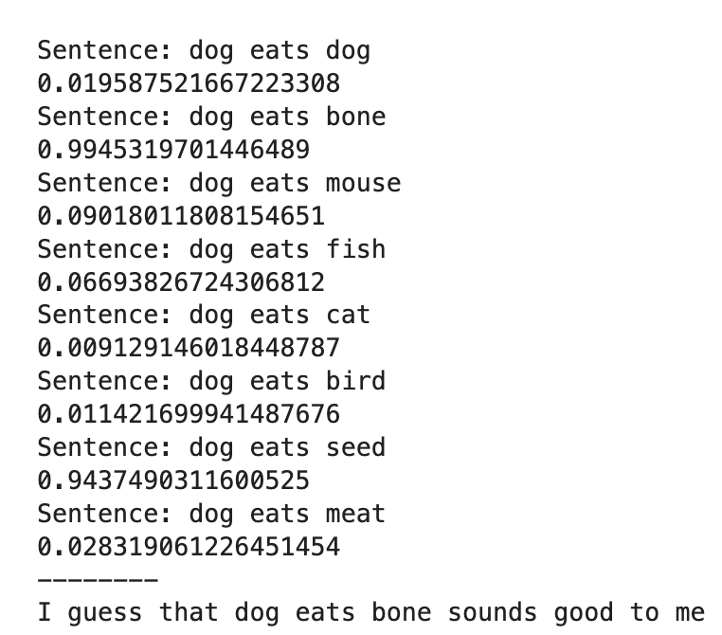
Experiments: Sentence completion
With the trained Word embeddings for the previous task, we are able to complete sentences according to the true\false score.
Further training is under consideration using the output of the measurementof the sentence category qubit/s as the input of a machine learning model.

Slide 10
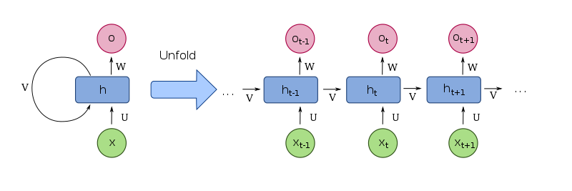
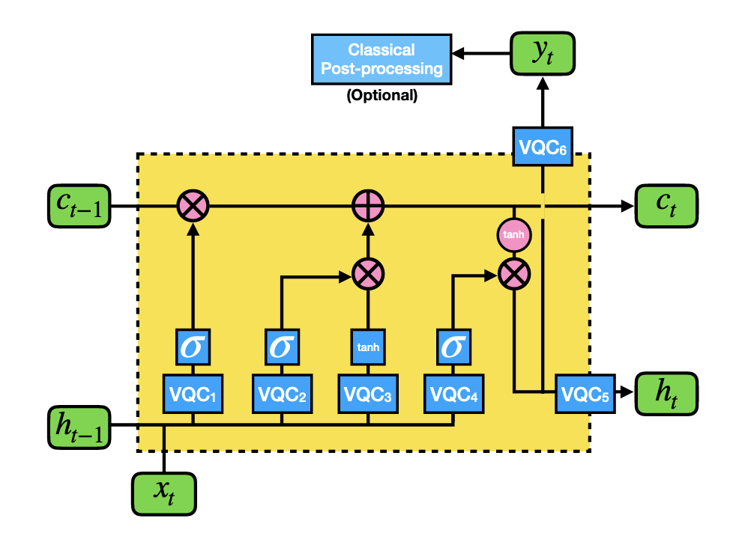
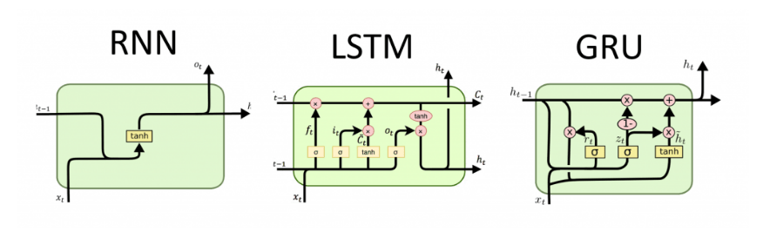
Classical NLP algorithms: Seq2seq models
Encoder-decoder structure
Hidden states
Information propagates through the network
Variable input/output size
Quantum LSTM have been proposed replacing feedforward layers by quantum circuits https://arxiv.org/pdf/2009.01783.pdf
MPS have inspired a class of RNNs that increase long range interactions https://arxiv.org/pdf/2112.08628.pdf
https://arxiv.org/pdf/2009.01783.pdf

Slide 11
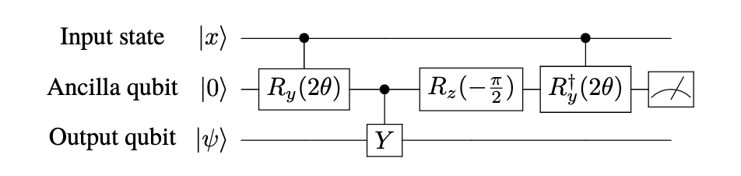
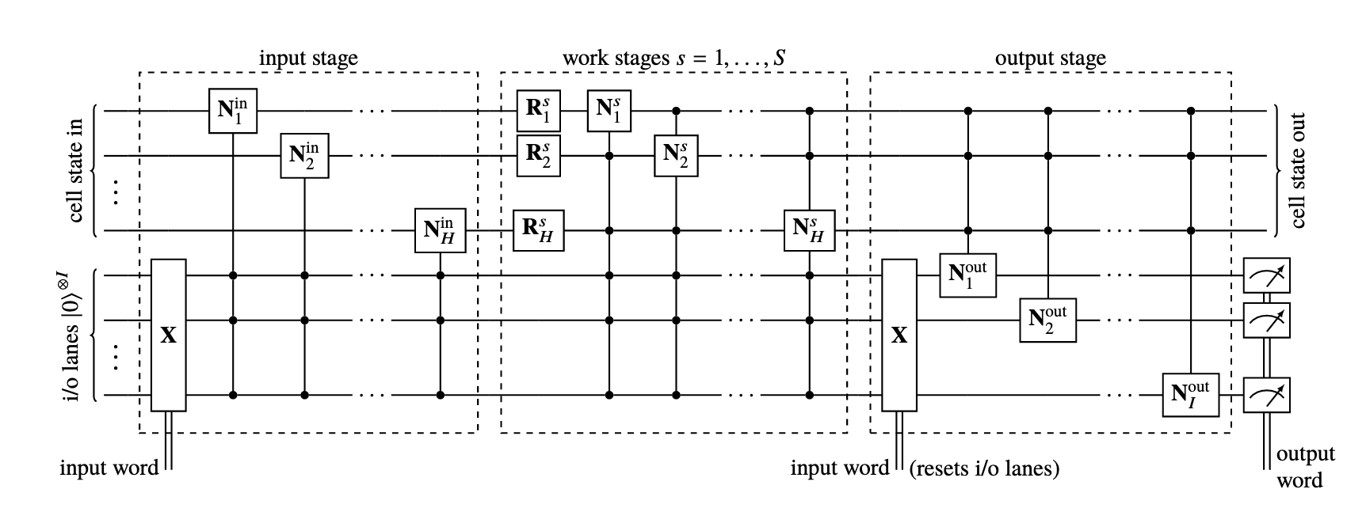
Quantum neurons
General building block for quantum networks able to process entangled states and add non-linear activation layer.
Can reproduce any classical activation
Quantum Recurrent Neural Networks
Tensor states such as MPs and MPOs can be used to simplify RNNs: https://arxiv.org/pdf/2006.05442.pdf
https://arxiv.org/pdf/1711.11240.pdf

Slide 12
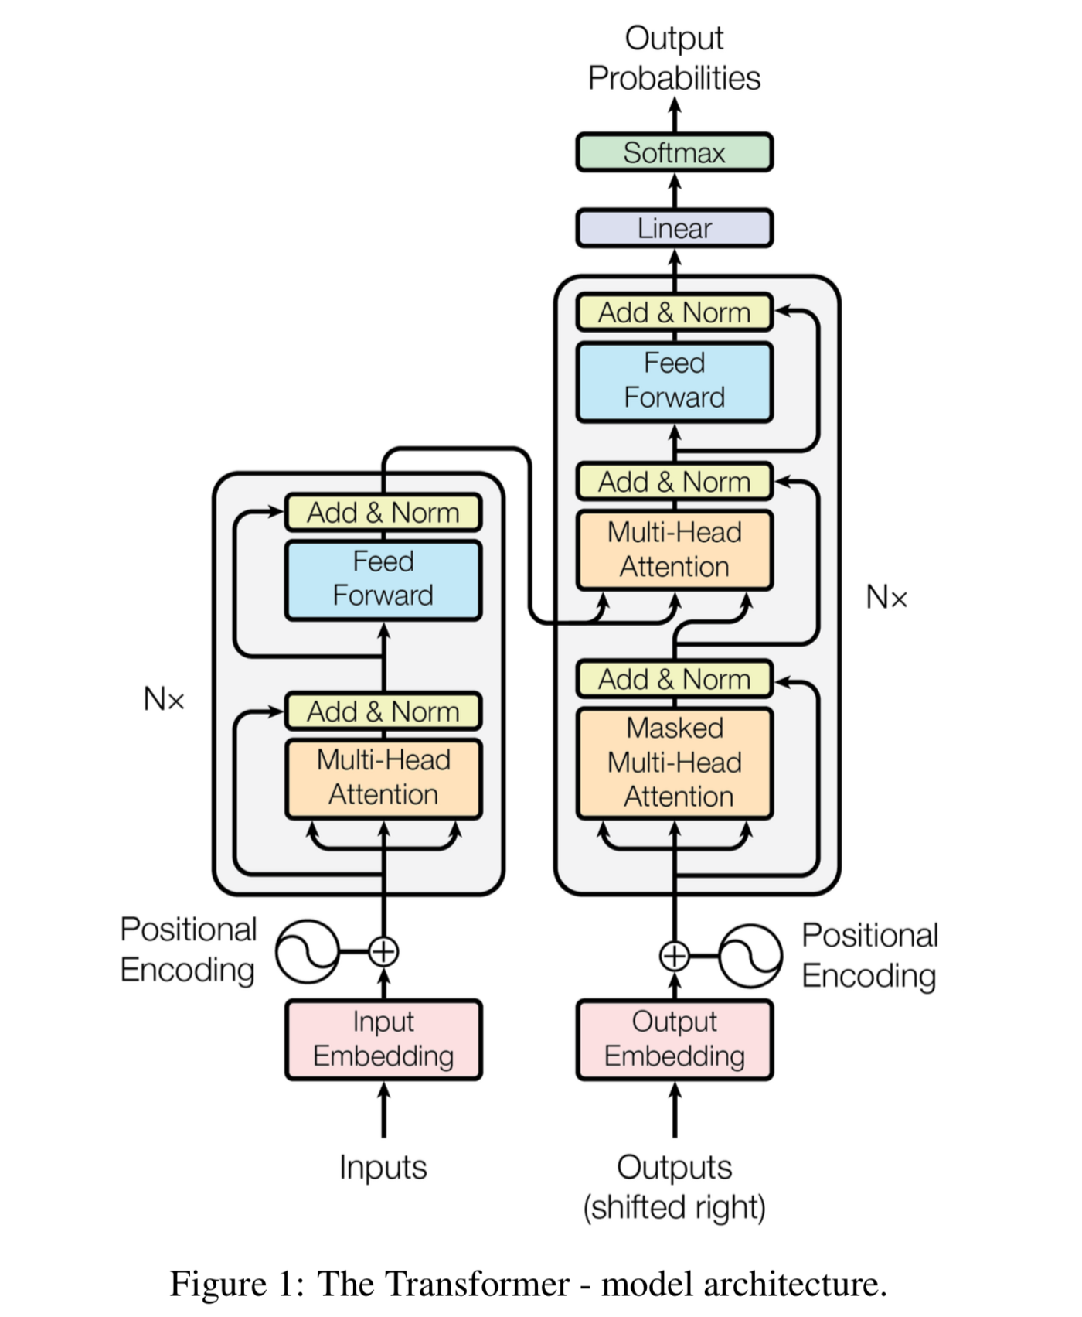
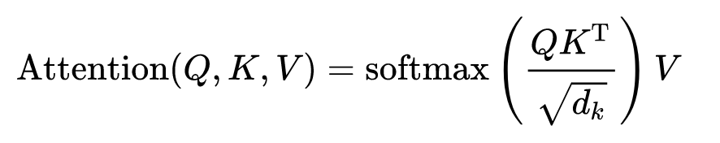
Classical NLP algorithms: Transformer
Attention layers assign Query, Key and Value embeddings for input tokens. Attention is calculated to measure word compatibility.
A positional encoding is added to the original word embeddings.
High degree of parallelization.
Quantum transformer:
Replace Q, K, V with operators https://arxiv.org/pdf/2110.06510.pdf
Can QC offer better positional encoding?
Is there a quantum alternative to attention?
https://arxiv.org/pdf/1706.03762.pdf

Slide 13


Dressed quantum circuits
Hybrid models that incorporate classical neural networks as pre/post processing layers for quantum circuits.
Dimensionality reduction allows to reuse classical pre trained embeddings.
Could be used to use existing NLP models for quantum circuits.
Dressed quantum circuit $\tilde{Q}$ is written as $\tilde{Q}=L_{n_{q}→n_{out}}∘Q$ $∘ L_{n_{in}→n_{q}}$, with $Q=M∘U∘ℇ$, where $M$ is the measurement, $U$ the parametrized unitary, and $ℇ$ a variational embedding layer.
Previously used in image classification in https://github.com/XanaduAI/quantum-transfer-learning
$$|0>$$
…
$$|0>$$
Variational quantum circuit / DisCoCat circuit
Text generation
Topic classification
Machine translation
Raw Data
Pretrained classical embedding

Slide 14
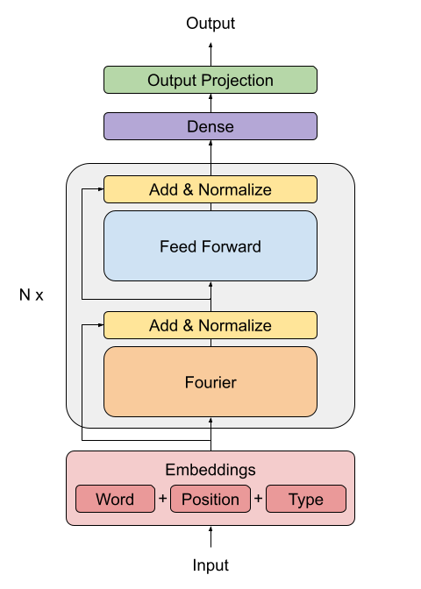
Transformer models beyond attention
Alternatives to attention:
Linformer
Performer
Fnet
XLNet
Quantum computing is very efficient in the implementation of certain transforms.
Quantum Fourier Transform and Discrete Cosine Transform are used in image compression.
These transforms could be used as kernels replacing the attention mechanism
Google’s FNet: Mixing Tokens with Fourier Transforms
https://arxiv.org/abs/2105.03824

Slide 15
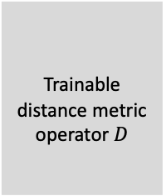





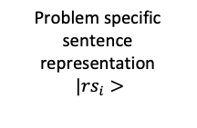
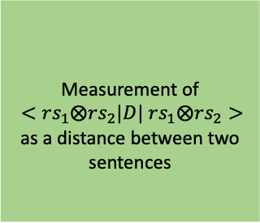
Topic classification architecture
Sentence quantum state
$$|s_{i}>$$
$$|0>$$
…
$$|0>$$
Discocat quantum circuit (word embedding + grammar layers)
DNN
Amplitude amplification?
Entanglement
Quantum neuron. Context trainable operator with non linear activation function
Entanglement
Classical high-dimensional
word embedding
Lower dimensional parameters
Sentence
Problem specific sentence representation$|{rs}_{i}>$
$$|0>$$
…
$$|0>$$
Once we have this richer sentence representation for several sentences:
Inspired by query-key compatibility measures in transformer architecture.
Several heads can be trained in parallel so the final decision is averaged.
Transfer learning: we reuse classical embeddings and also can use the quantum word embedding for different task or contexts.
Trainable distance metric operator $D$
Measurement of
$<rs_{1}⨂rs_{2}|D|$ $rs_{1}⨂rs_{2}>$
as a distance between two sentences
$$|{rs}_{1}>$$
Classical topic classification (k-means, random forest, etc.)
$$|{rs}_{2}>$$

Slide 16

Word compatibility using word entanglement in DisCoCat
Discocat quantum circuit (word embedding + grammar layers)
Word embedding
Compositional grammar
$$|0>$$
…
$$|0>$$
Sentence
H
Parametrized operator encoding information about entanglement between words
H
Positional encoding ?
H

